Slide 1
Chiba campaign 2022
DAI YAJIE
Date：2022/12/5
Report date 2022/12/2-12/4

Slide 2
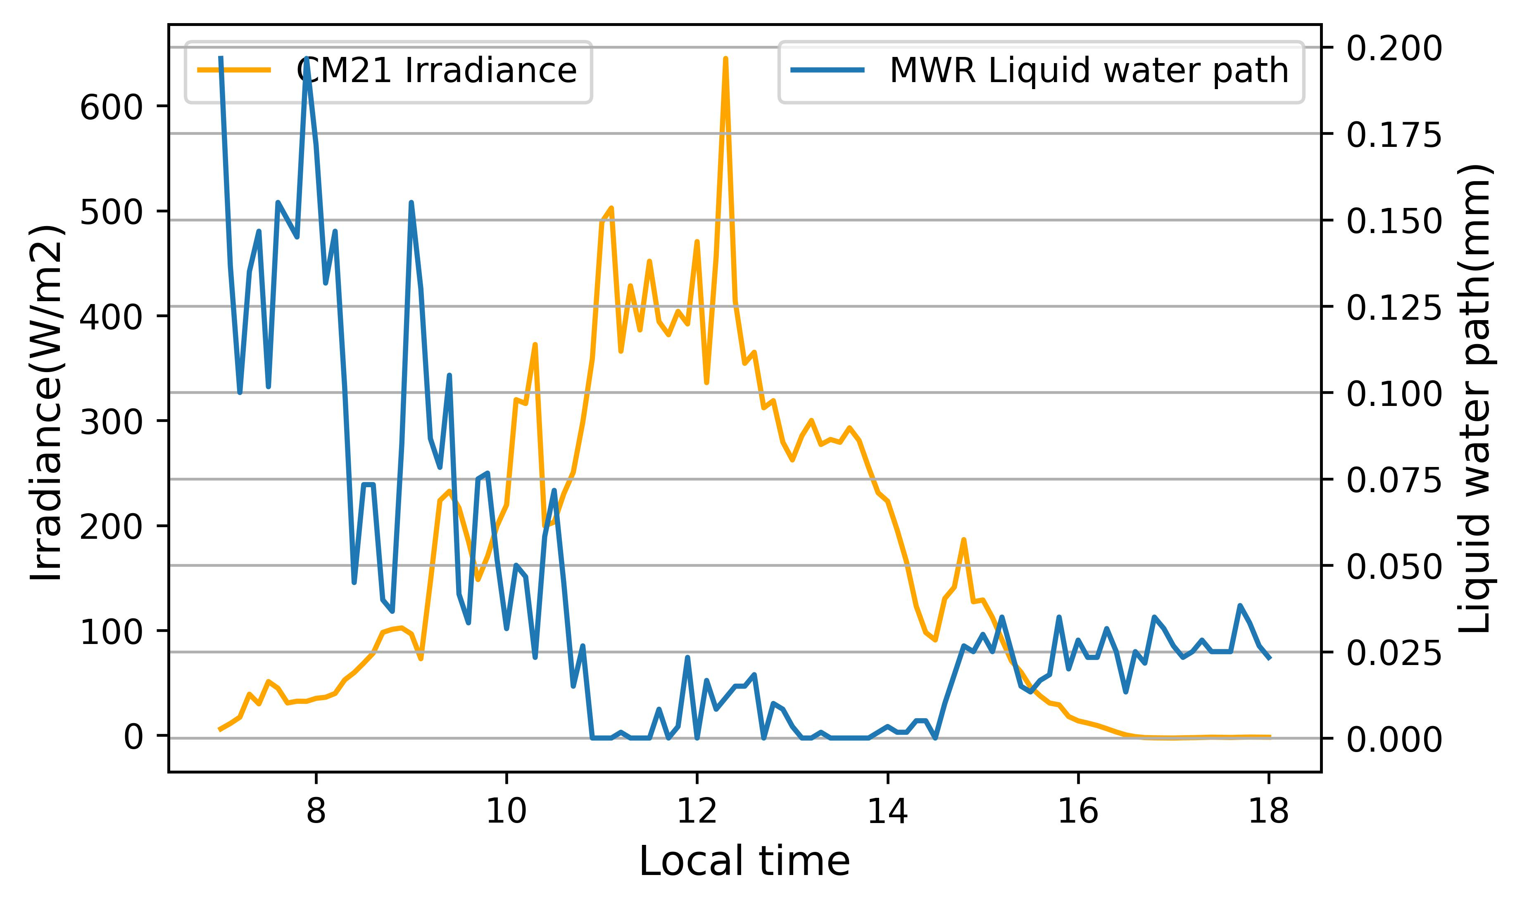
Solar radiation
2022/12/2
Cloudy&Sunny
Sunrise time：6:33
Sunset time：16:27

Slide 3
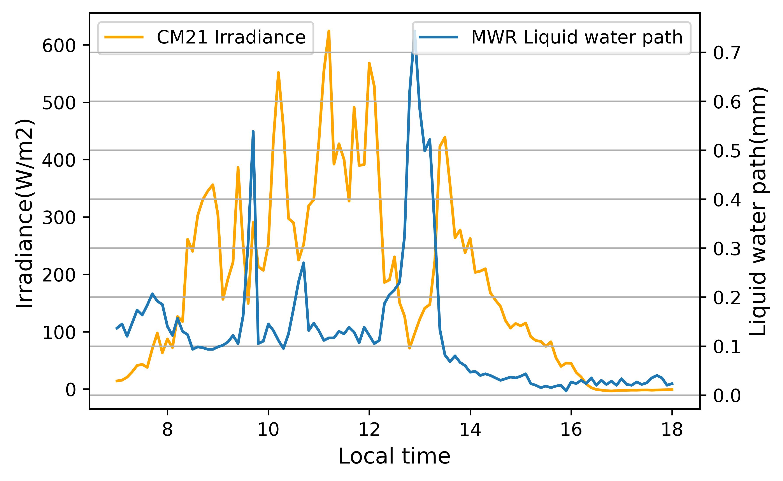
Solar radiation
2022/12/3
Cloudy
Sunrise time：6:34
Sunset time：16:27

Slide 4
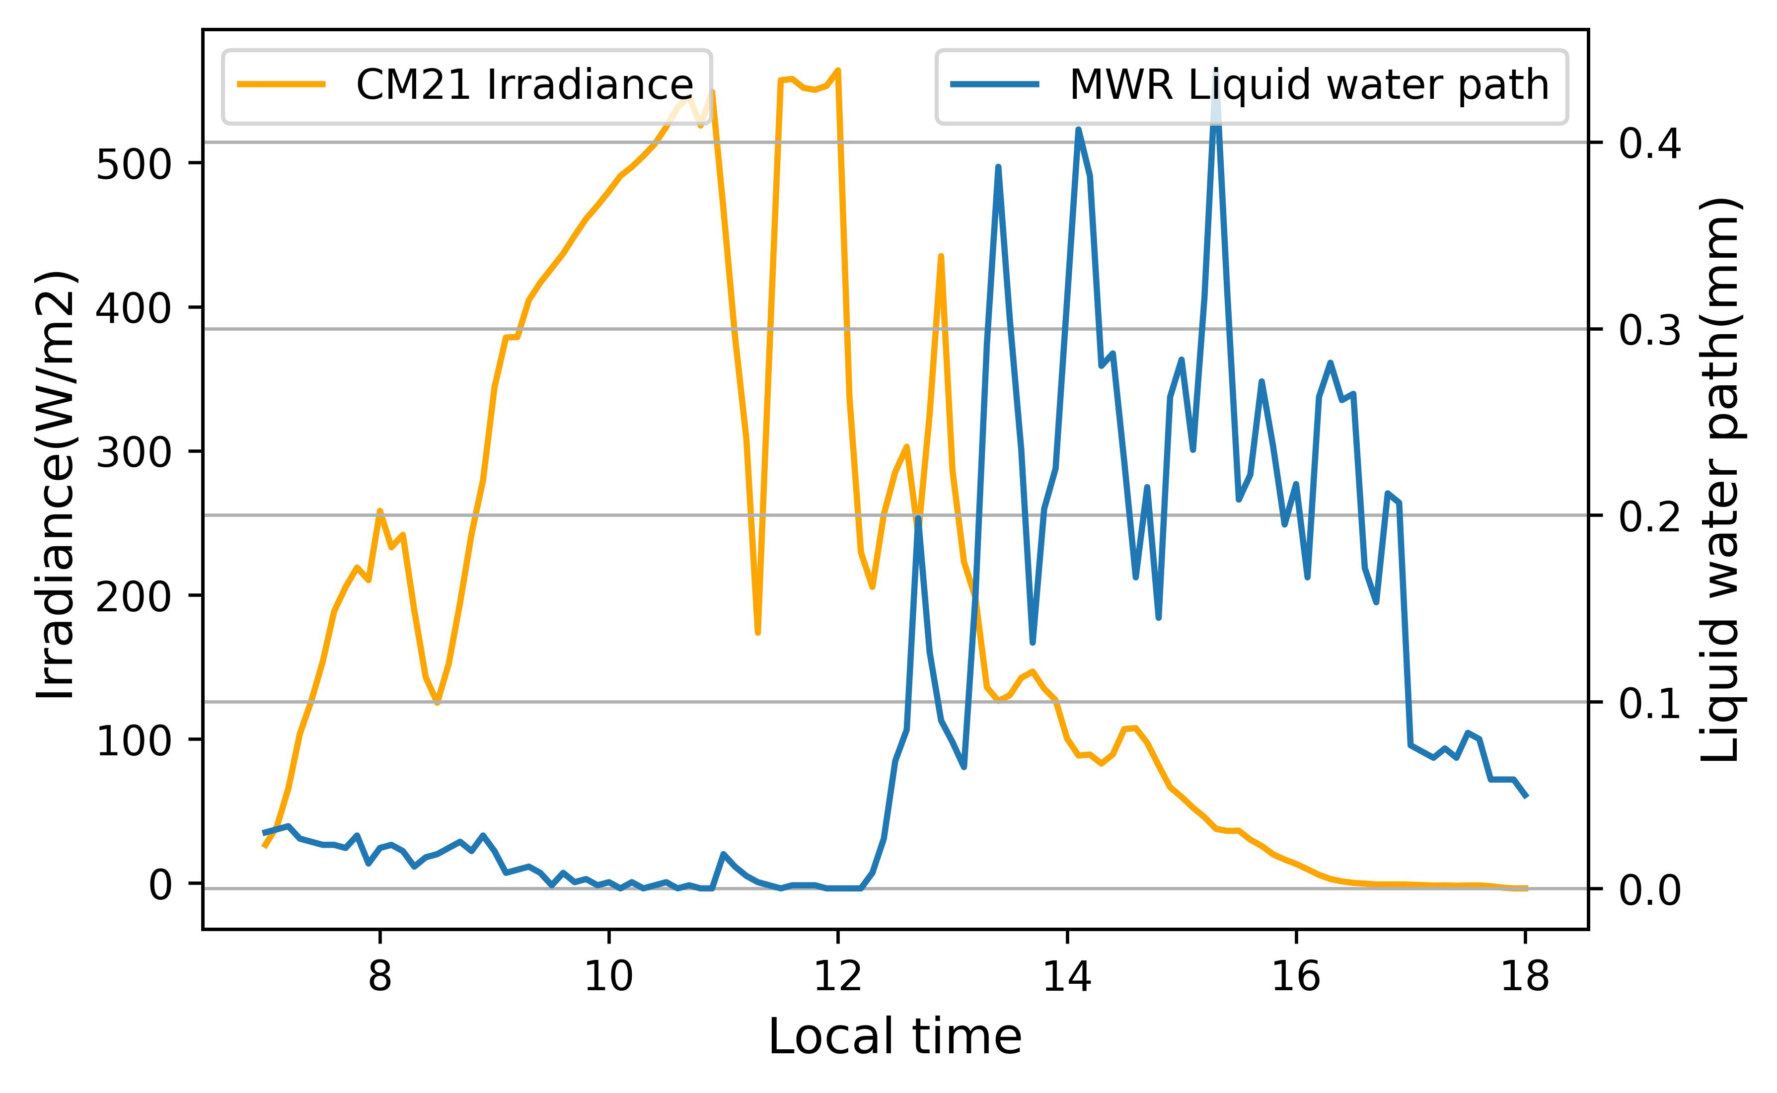
Solar radiation
2022/12/4
Sunny&Cloudy
Sunrise time：6:34
Sunset time：16:27

